Slide 1
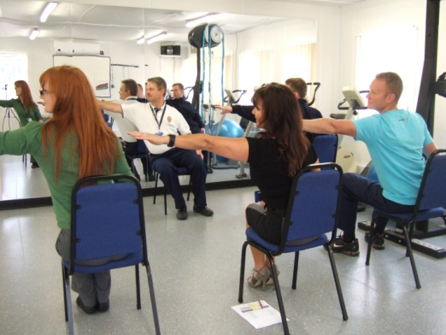
“ Practical Man
Pain
Comments from last year’s participants
“ Hands on sessions are very good”
“Grand Round excellent and something different to other courses” “ Greatly Improved my understanding “
Relief
Foundation
Book Your Study Leave Now
Fee £395
with course dinner.
If paid after 30th April
£500
T h i s p r a c t i c a l a n d i n t e r a c t i v e c o u r s e
i s d e s i g n e d f o r P r o f e s s i o n a l s treating Pain
a n d t r a i n e e s a i m i n g t o f u r t h e r d e v e l o p
s k i l ls in a s s e s s i n g a n d t r e a t i n g c o m p l e x
c h r o n i c p a i n p a t i e n t s
Limited only to 30 participants
Liverpool Course On Clinical
Management of Chronic Pain
“A Practical Approach”
6th to 8th July 2017
Receive complimentary copy of the Award Winning
“ Practical Management of Complex Cancer Pain”
D e m o n s t r a t i o n J o i n t P a i n C l i n i c s I m a g i n g f o r
S p i n a l I n t e r ve n t i o n s C R P S Pelvic Pain N e u r o m o d u l a t i o n P a i n M a n a g e m e n t P r o g r a m m e
D e m o n s t r a t i o n T h e a t r e s Hands-On Manikin
Spinal Injection U SG G u i d e d P a i n I n t e r ve n t i o n s
B o t o x i n j e c t i o n s & C a p s a i c i n P a t c h Appl i c a t i o n
Physiotherapy Assessment and External
Neuromodulation Cancer Pain
W h o s h o u l d a t t e n d : An a e s t h e t i c , N e u r o s u r g e r y a n d
P a i n Tr a i n e e s . P a i n C o n s u l t a n t s , G P s w i t h S p e c i a l
I n t e r e s t i n P a i n M e d i c i n e , Ad va n c e d N u r s e
P r a c t i t i o n e r s a n d S e n i o r P h ys i o t h e r a p i s t s w i t h
s p e c i a l i s t i n t e r e s t i n m a n a g e m e n t o f c h r o n i c p a i n .
Contact:
Mrs. Brenda Hall
Pain Relief Foundation
Clinical Sciences Centre
University Hospital Aintree
Liverpool L9 7AL
UK Tel: 0151 529 5822
b.hall@painrelieffoundation.org.uk Revalidation
Register Online at www.painrelieffoundation.org.uk FOR ANAESTHETISTS
RCoA CPD Matrix:
2E03 & 3E00

